Slide 1

Exploring Research Administration from Concept to Commercialization
Facility Security
Presented by:
Dela Williams

Slide 2






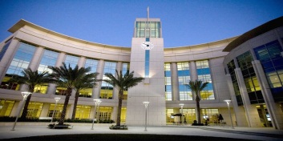

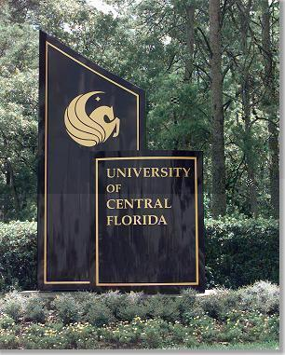


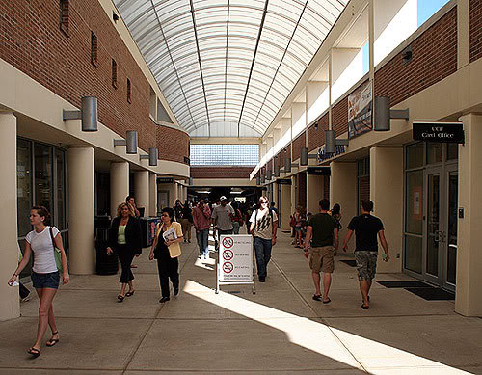


Facility Security

Slide 3
Security Message
The protection of Government assets, people and property, both classified and controlled unclassified, is the responsibility of each and every member of the Department of Defense and its contractors, regardless of how it was obtained or what form it takes. Our vigilance is imperative in the protection of this information. Anyone with access to these resources has an obligation to protect it.
The very nature of jobs in security dictates we lead the way in sound security practices. Anything less is simply not acceptable.

Slide 4
Contents
Physical Security
Personnel Security
Information Security
Antiterrorism/Force Protection
Information Assurance
Public Release of Information Operations Security
Reporting Requirements
Regulations
Closing

Slide 5
Objective
This briefing will:
      Identify personal security responsibilities
      Provide a basic understanding of DoD security policies
      Explain the importance of protecting government assets

Slide 6
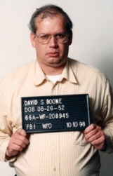
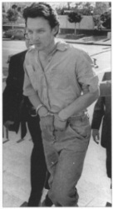

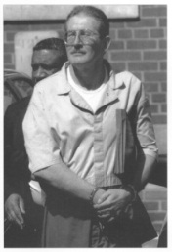
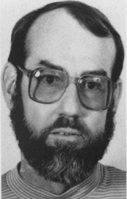
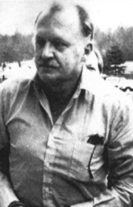
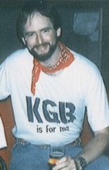
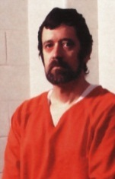
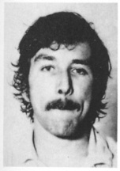
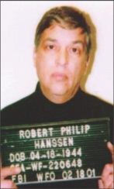
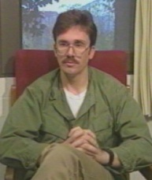

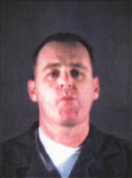
Why Security?
DoD Security Regulations, Directives, and Programs are established to counter threats
Threats to classified and unclassified government assets can include:
        Insider (government employees, contractor employees, and authorized visitors)
        Criminal and Terrorist Activities
        Foreign Intelligence Services
        Foreign Governments

Slide 7
Physical Security
Physical security offers security-in-depth, and includes, but is not limited to:
        Perimeter fences
        Employee and visitor access controls
        Badges/Common Access Cards (CAC)
        Intrusion Detection Systems
        Random guard patrols
        Prohibited item controls
        Entry/exit inspections
        Escorting
        Closed circuit video monitoring

Slide 8

Individual Responsibility
Responsible for:
        Becoming familiar with local security regulations pertaining to assigned duties
        Notifying Security Official of changes in status which could affect security clearance, defined later in this briefing.

Slide 9
Security Clearance
A person’s position sensitivity and/or duties will determine their level of clearance or access
There are three levels of security clearance:
        Top Secret
        Secret
        Confidential

Slide 10

Investigation and Clearance
All DoD government and contractor personnel are subject to a background investigation
Investigations are conducted to determine suitability for a position of trust and/or granting of a security clearance
A person’s suitability is continually assessed
Refer to DoD 5200.2-R, DoD Personnel Security Program, Chapter 9 for full details

Slide 11
CLEARANCE
Administrative action, usually involving a form of background investigation and adjudication determination
+
SF 312
ACCESS
Classified Information Nondisclosure Agreement:
All persons authorized access to classified information are required to sign a SF 312, a legal contractual agreement between you and the
U.S. Government.
=
The ability and opportunity
to obtain knowledge of
classified information.
This can involve seeing,
hearing, or touching classified information, material, or equipment.
+
NEED TO KNOW
Determination made by an authorized holder
of classified information that a prospective recipient requires access to perform a lawful and authorized government function.

Slide 12


Must…
Coordinate with local security official regarding debriefings and/or out-processing requirements

Slide 13
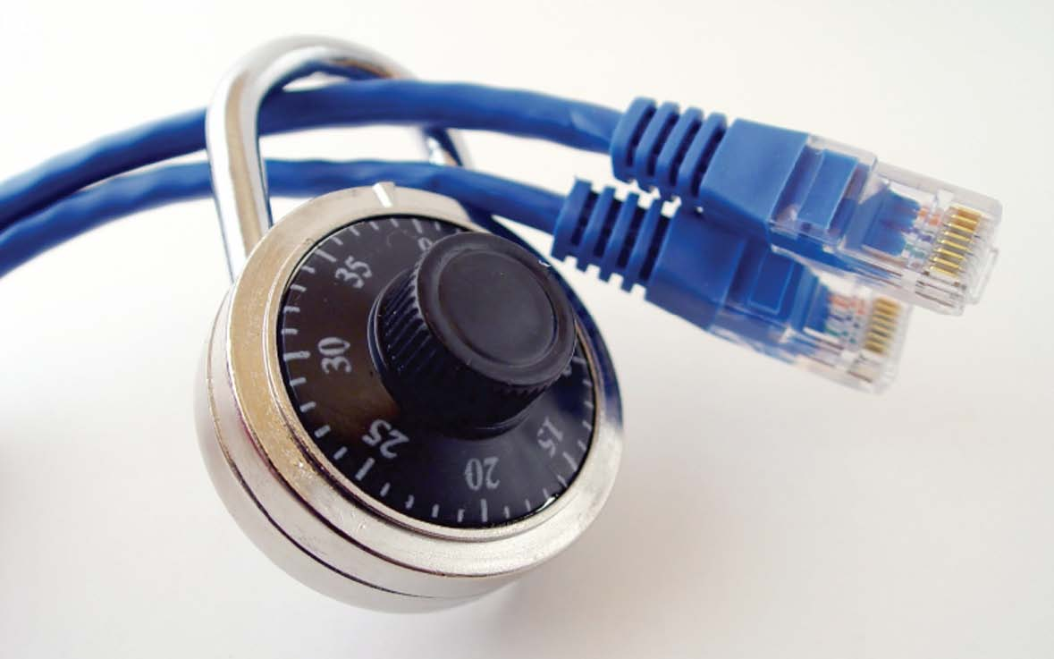
Information Security
Pertains to the protection of classified and sensitive information, to include but not limited to:
        Marking
        Handling
        Transmission
        Storage
        Destruction

Slide 14
Classification Levels
There are THREE levels of Classification
TOP SECRET
Exceptionally Grave Damage to the National Security
SECRET
Serious Damage to the National Security
CONFIDENTIAL
Damage to the National Security

Slide 15

Classified Material can include ANY of these and must be properly marked:
Machinery, Documents
Emails, Models, Faxes
Photographs, Reproductions
Storage Media, Thumb Drives
Working Papers, Meeting Notes
Sketches, Maps, Products,
Substances, or Materials

Slide 16

How Do I Identify Classified Documents?
?
All classified information must be appropriately marked to alert potential recipients to the information’s classification.
CONFIDENTIAL
(C)
SECRET
(S)
TOP SECRET
(TS)

Slide 17
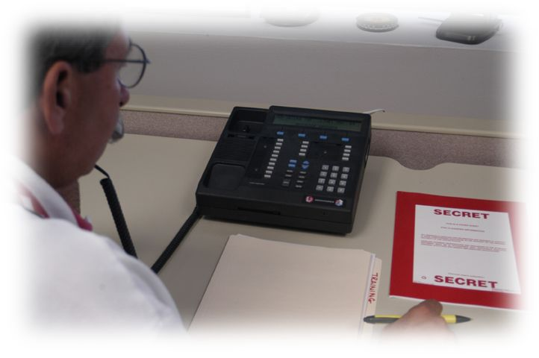
Classified Information:
Must be under the control or guarded by an authorized
person or stored in a locked security container, vault, secure room, or secure area
Must be discussed on secure telephones or sent via secure communications
Must be processed on approved equipment
Must be destroyed by approved methods
Must be discussed in an area authorized for classified discussion.

Slide 18
Antiterrorism/Force Protection
Defensive measures used to reduce the vulnerability of individuals and property to terrorist acts, including limited response and containment by local military and civilian forces
Actions taken to prevent or mitigate hostile actions against DoD personnel and its contractors (including family members), resources, facilities, and critical information

Slide 19
Information Assurance (IA)
In the performance of a person’s duties they may be required to have access to government computer systems
Information assurance protects and defends information and information systems by ensuring their availability, integrity, authenticity, and confidentiality

Slide 20
DoD IA Responsibilities
Participate in annual IA training inclusive of threat identification, physical security, acceptable use policies, malicious content and logic, and non-standard threats such as social engineering
Comply with password or pass-phrase policy directives and protect passwords from disclosure
If needed, additional computer security training can be provided.

Slide 21
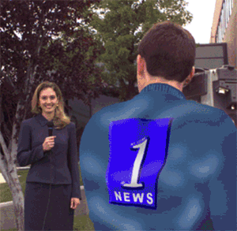
Public Release of Information
Public release of government information must first be approved by the Public Affairs Office or Sponsoring Agency

Slide 22

Operations Security “OPSEC”
Operations Security (OPSEC) is a systematic process used to mitigate vulnerabilities and protect sensitive, critical, or classified information

Slide 23



Reporting Requirements…
Must Report Change of:
Name
Marital Status
Citizenship

Slide 24


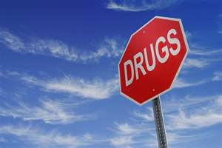
Must Report…
Adverse information concerning yourself or a
co-worker
Adverse information includes, but is not limited to recent arrests, alcohol or drug related problems, and/or financial difficulties, etc

Slide 25

Must Report…
Loss, compromise,
(or suspected loss or compromise) of classified information, including evidence of tampering with a security container used for storage of classified information

Slide 26
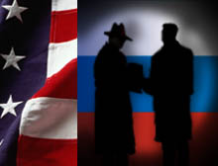
Must Report…
All continuing contacts with foreign nationals, to include shared living quarters and marriage
Suspicious contacts with/by foreign nationals

Slide 27

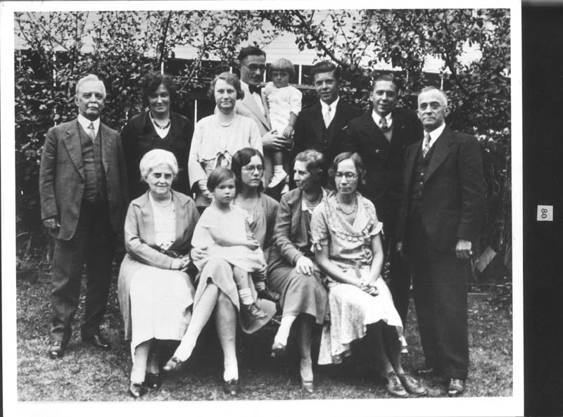


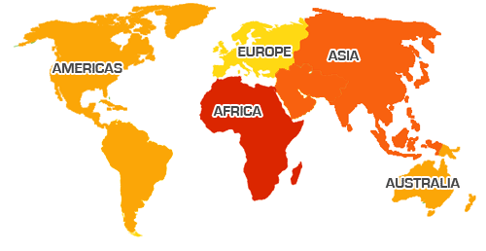
Must Report…
If a member of a person’s
immediate family
(or their spouse’s
immediate family)
is a citizen or resident
of a foreign country

Slide 28



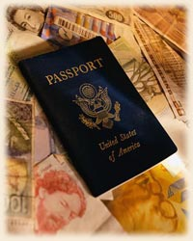


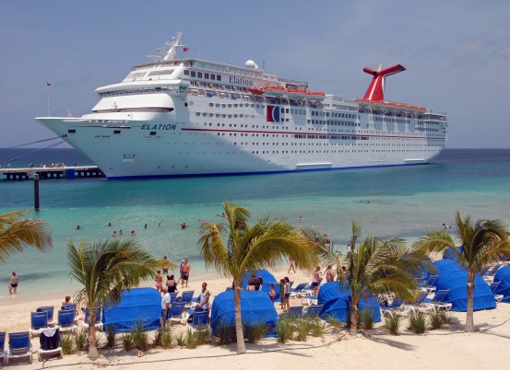
Must Report...
Foreign travel in accordance with agency’s policies and procedures

Slide 29
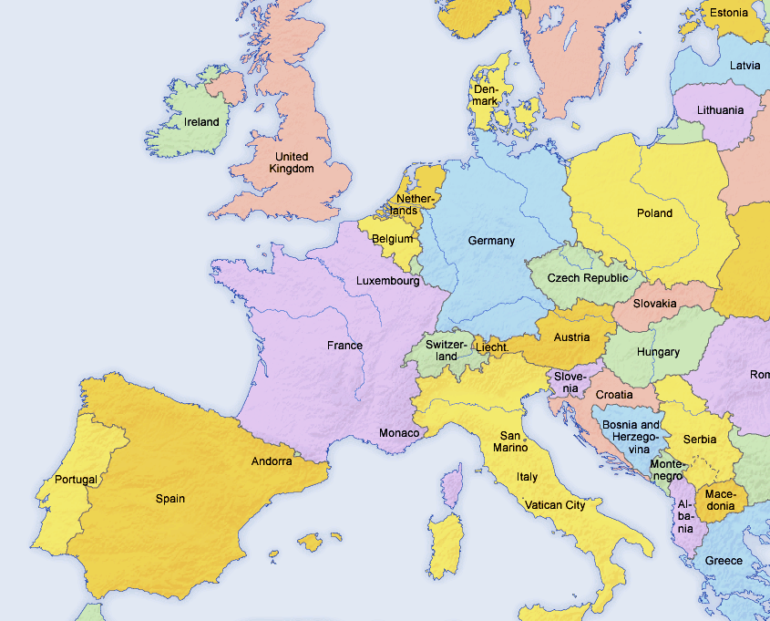
Must Report…
Any potential employment or service, whether compensated or
volunteer, with a
foreign government,
foreign national,
foreign organization,
or other entity, or a
representative
of any foreign
interest

Slide 30
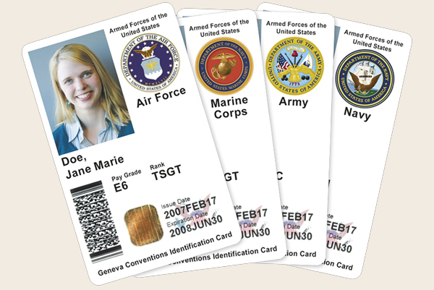
Must Report…
A lost or stolen badge or Common Access Card (CAC) immediately to Security Official or office that issued the card.

Slide 31
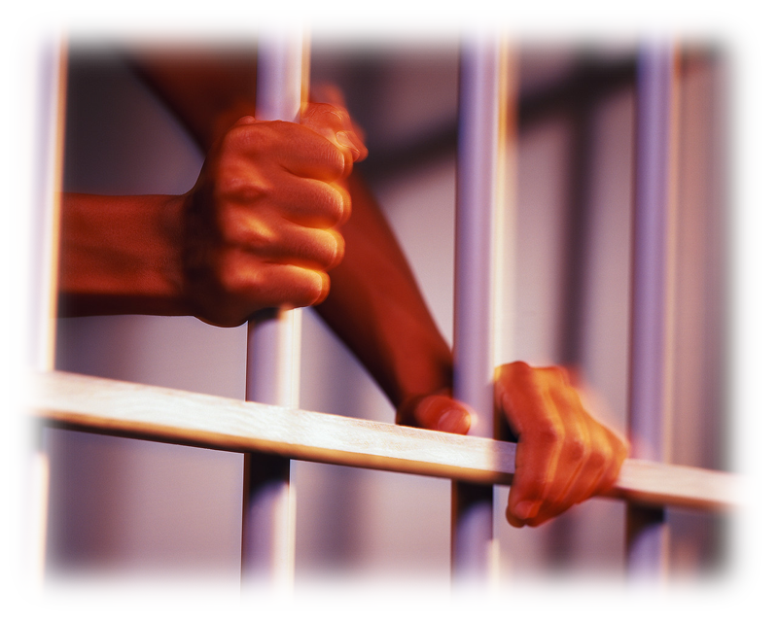
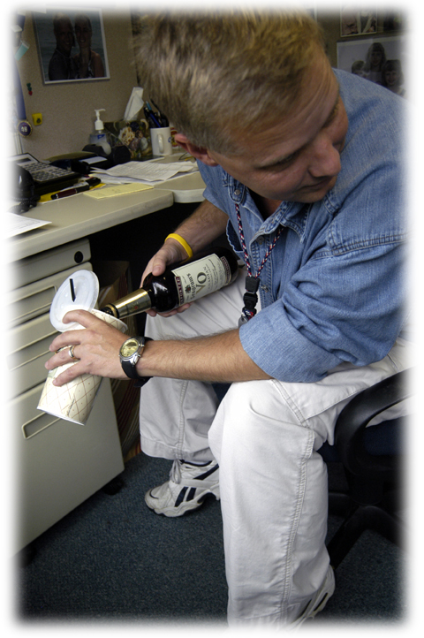

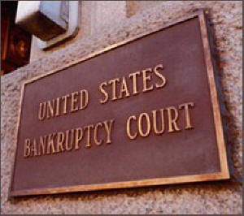
Must Report …
All holders of a security clearance must report information to their security office that might have a bearing on their continued eligibility for access to classified information

Slide 32
Must Report …
Potential Espionage Indicators Exhibited by Others
      Unexplained affluence
      Keeping unusual work hours
      Divided loyalty or allegiance to the U.S.
      Disregarding security procedures
      Unreported foreign contact and travel
      Pattern of lying
      Attempts to enlist others in illegal or questionable activity
      Verbal or physical threats
      Inquiry about operations/projects where no legitimate need to know exists
      Unauthorized removal of classified information
      Fraud/Waste/Abuse of government credit cards and/or travel or training advances

Slide 33
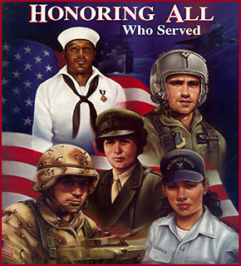
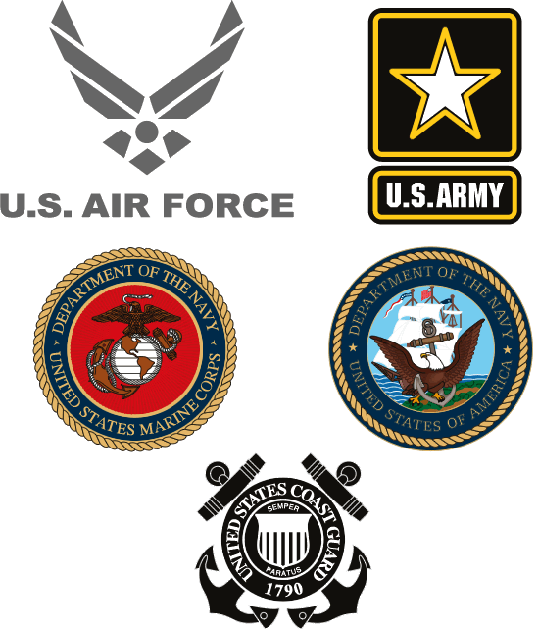

MAKE A DIFFERENCE!
Security is a team effort . . . Diligence in promptly reporting concerns and adhering to sponsoring agency’s security policies and procedures will ensure the integrity of national security. As a team, we can protect our warfighters, colleagues, and families from potential harm.

Slide 34
Security Regulations
Reference Security Regulations, not all inclusive:
      Executive Order 12958, as amended - Classified National Security Information
      Executive Order 12968 – Access to Classified Information
      Director of Central Intelligence Directive No 6/4
      DoD 5200.1-R, DoD Information Security Program
      DoD 5200.2-R, DoD Personnel Security Program
      DoDD 5205.2, DoD Operations Security (OPSEC) Program
      DoD 5200.8-R, DoD Physical Security Program
      DoDD 8500.1, Information Assurance
      DODI 8500.2, Information Assurance Implementation
      DoDD 2000.12, DoD Antiterrorism (AT) Program
      Homeland Security Presidential Directive (HSPD)-12

Slide 35


Questions…

Slide 36

THANKS FOR JOINING US!
See you at the next session:
Investigation and Audit Mitigation
November 6,2013
9:00am-11:00am
ORC 2nd floor large (#211)

